Slide 1




Group 4
FALL 2023
MAVERICK CAPSTONE PROJECT
PRESENTATION
JADE GOSAR
KARSON EILERS
PAULA STEFANI
GARISH PRAJAPAT
This is not a Maverik Presentation

Slide 2

Intro
Business Problem
Approach
EDA
Models
Results
VAR Model Demo
Thank you
AGENDA

Slide 3

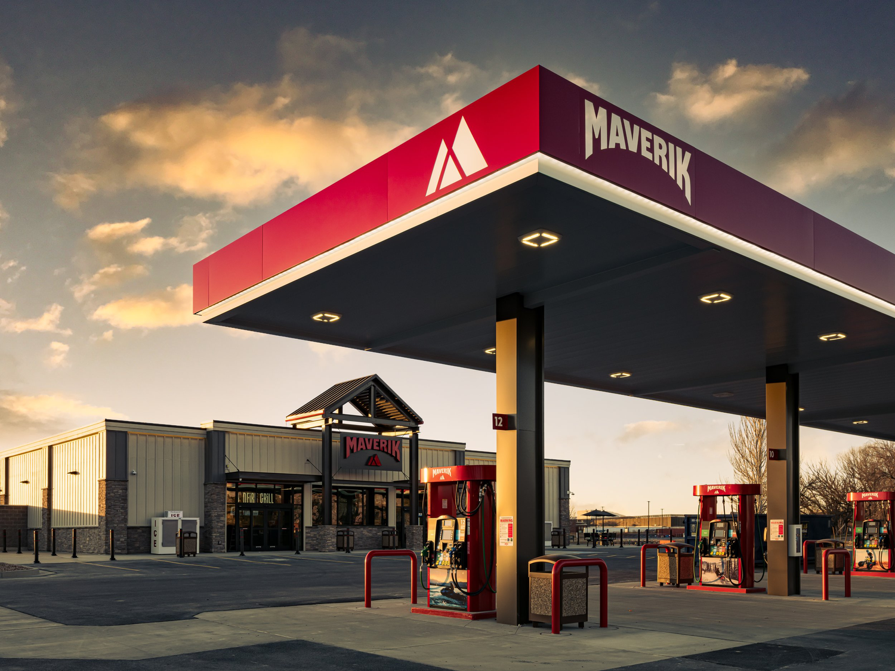
Group 4 Fall 2023
About Maverik
Metrics: Food Sales, Inside Sales, Diesel and Unleaded
Data was composed by time series and qualitative
Capstone Project Fall 2023

Slide 4


Group 4 - Fall 2023
BUSINESS PROBLEM
Maverik faces the unique challenge of forecasting and evaluating first-year sales performance expectations for each new location.
Insufficient historical data, complex sales predictors, varying trends, and market fluctuations complicate modeling efforts for new stores
An accurate forecasting model will enable Maverik to improve financial planning, develop strategies, and provide a more accurate initial ROI documentation

Slide 5

Data Preparation
Recommendation
Statistical Analysis
Interpreation &
Deployment
Exploratory Data Analysis
Distributions & Graphs
Presentation
Implementation
Correlation Analysis
Model Evaluation
Stakeholder Input
Model Creation
APPROACH
LASSO
ARIMA
VAR
Group 4 Fall 2023

Slide 6
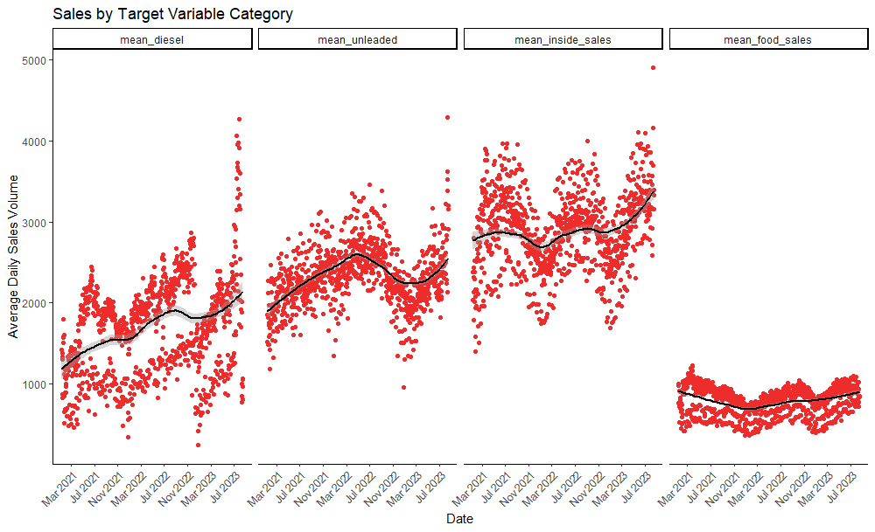
Sales By Target Variable Category
Exploratory Data Analysis
Group 4 Fall 2023

Slide 7
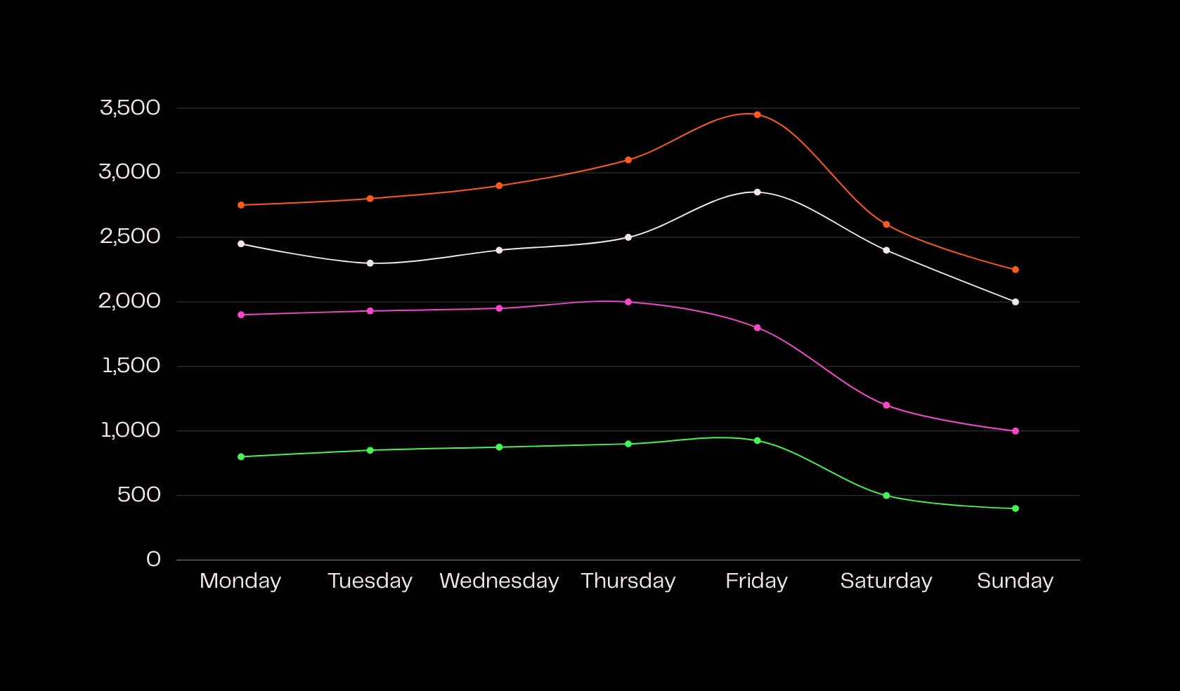




Sales Variation By Day Of The Week
Inside Sales
Unleaded
Diesel
Food Sales

Slide 8
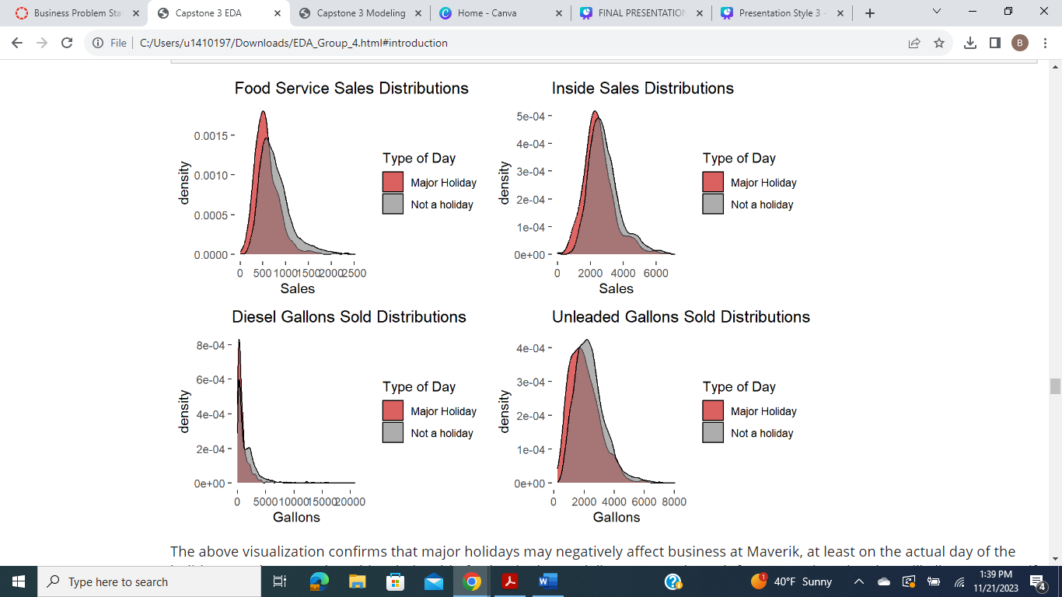
Group 4 Fall 2023
Holidays
Distributions for the four different metrics for Major Holidays Vs Non Major Holiday days. Major holidays may negatively affect business at Maverik, at least on the actual day of the holiday.

Slide 9
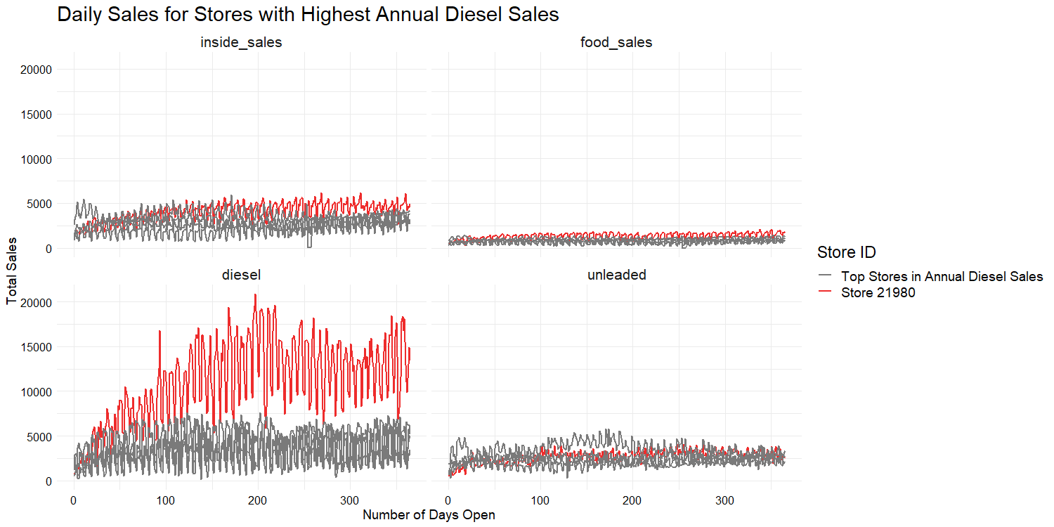
DAILY SALES
Selected Stores
Group 4 Fall 2023

Slide 10

LASSO
Creation of a loop in which previous sales metrics would be added as a lag historical data for prediction.
VAR
We trained the model on the mean values by each observed day, using the 80% training set.
ARIMA
Creation of a model capable of incorporating lagged time effects, qualitative factors, and detect seasonality trends.
MODELING
Different Models Implemeted

Slide 11

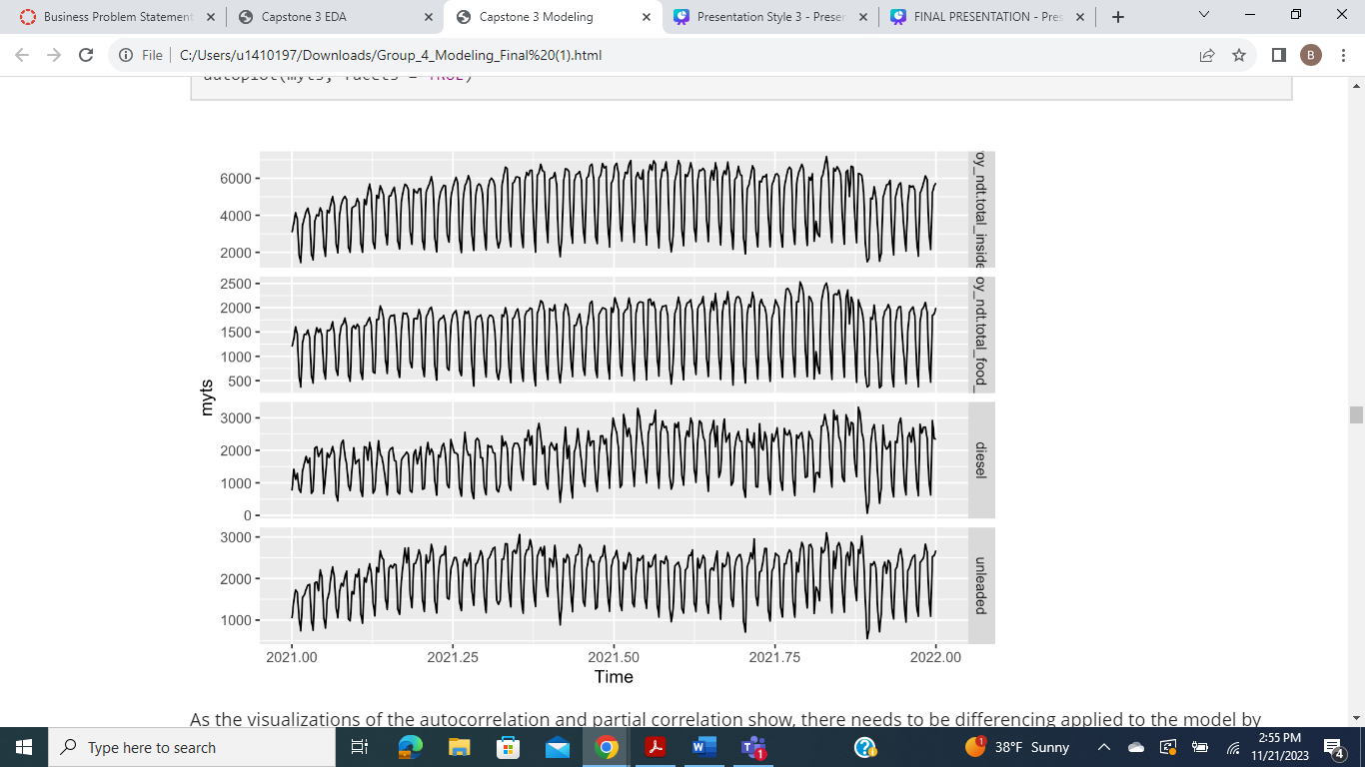

DATA
The Nature of the Data presented in the Dataset and How it Impacts Model Creation
Group 4 Fall 2023

Slide 12
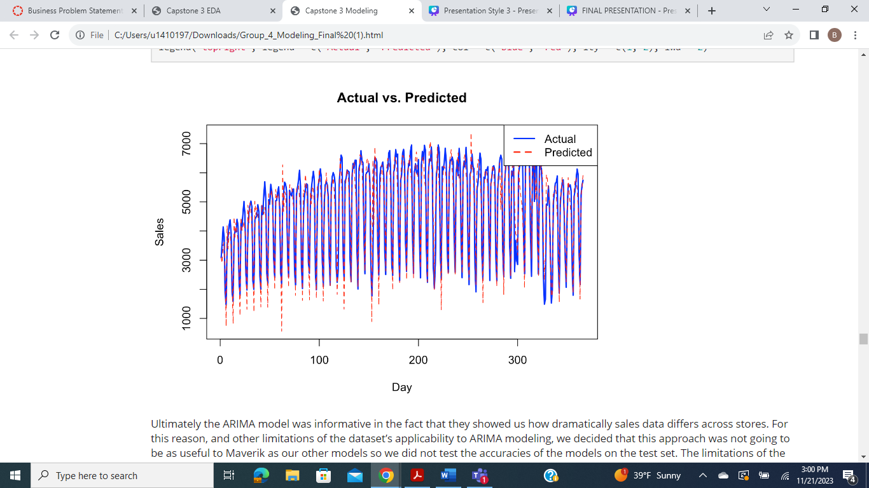
ARIMA
Group 4 Fall 2023
Actual Vs Predicted Results
The limitations of the dataset nature made the creation of a singular ARIMA model on all the available information difficult. Instead each store had to be treated as a singular time series object for Arima to suceed.

Slide 13
Metric | ARIMA RMSE | VAR RMSE | Benchmark RMSE
Merch two week pred rmse | 1220149 | 306819 | 268521
Merch three week pred rmse | 1196306 | 291722 | 243858
Food two week pred rmse | 316649 | 115923 | 68860
Food three week pred rmse | 310470 | 110660 | 66252
Unleaded two week pred rmse | 759050 | 198680 | 302827
Unleaded three week pred rmse | 734270 | 202672 | 259909
Diesel two week pred rmse | 447000 | 1309861 | 558546
Diesel three week pred rmse | 445735 | 1288705 | 482976
RMSE
Between
Models

Slide 14


Application
Vector Autoregressive Model Demo
https://h52d0s-karson-eilers.shinyapps.io/mav_app_final/
Group 4 Fall 2023

Slide 15


Thank You

